Slide 1

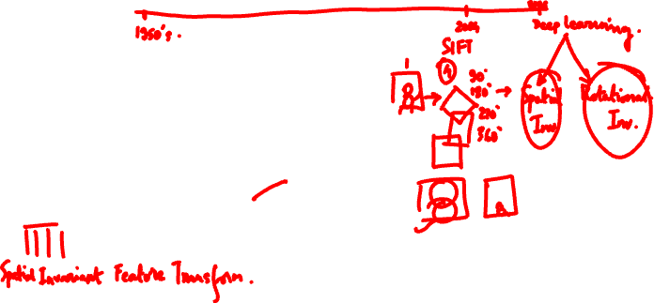
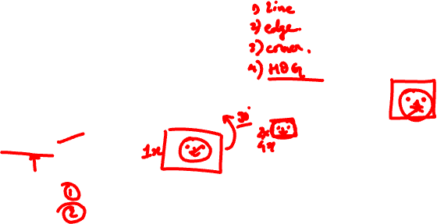
Session #7:
SIFT
Dhruba Adhikary
Dhruba.a@wilp.bits-pilani.ac.in
Credits: Slides adopted from Shree K Nayar’s lectures

Slide 2
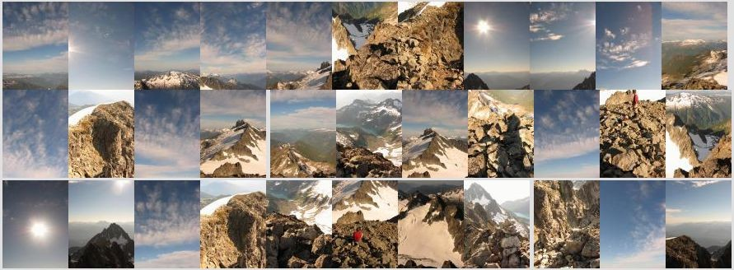

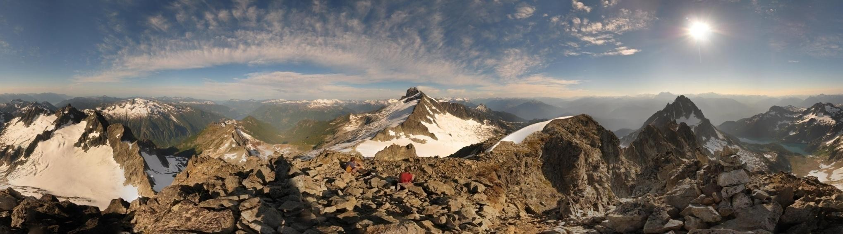

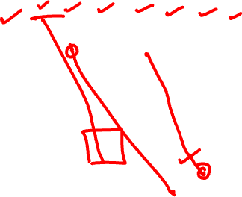
Motivation: Automatic panoramas
Credit: Matt

Slide 3
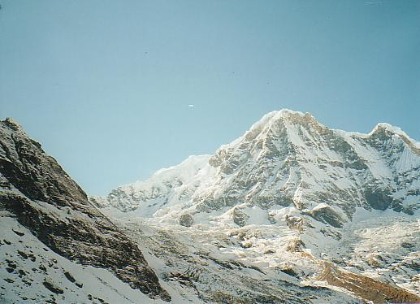
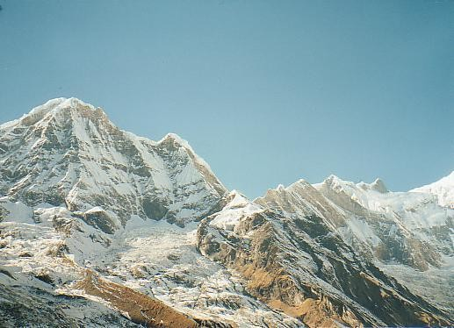
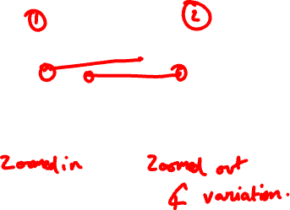
Why extract features?
Motivation: panorama stitching
– We have two images – how do we combine them?

Slide 4
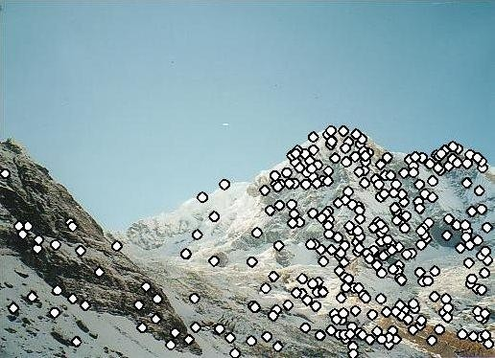
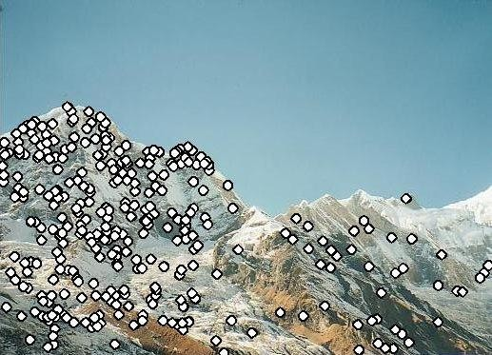


Why extract features?
Motivation: panorama stitching
– We have two images – how do we combine them?
Step 1: extract features
Step 2: match features

Slide 5
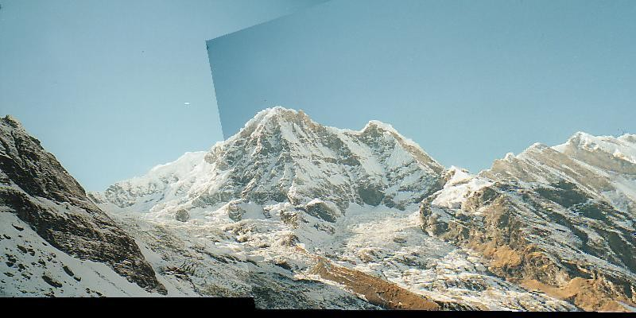
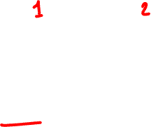

Why extract features?
Motivation: panorama stitching
– We have two images – how do we combine them?
Step 1: extract features
Step 2: match features
Step 3: align images

Slide 6
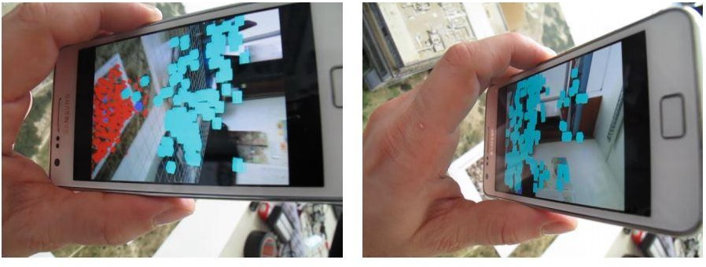


Application: Visual SLAM
(aka Simultaneous Localization and Mapping)

Slide 7
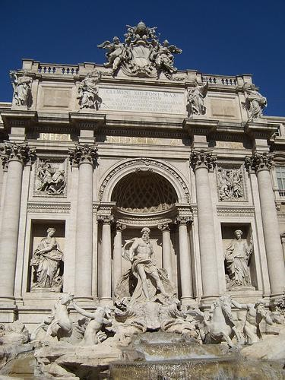
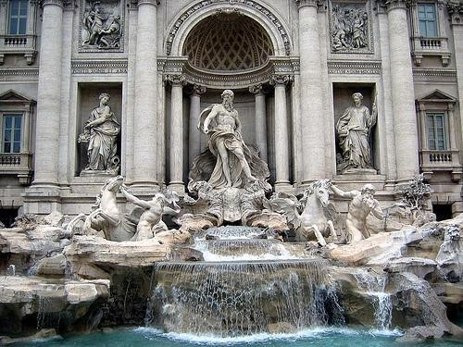

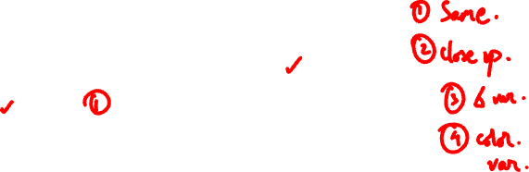
Image matching
by Diva Sian
by swashford

Slide 8
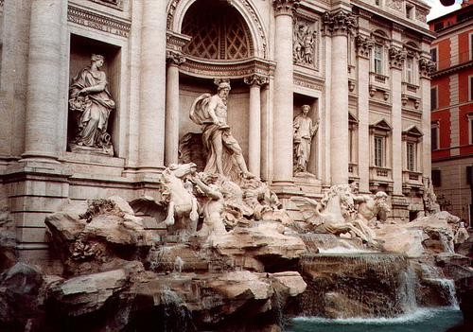
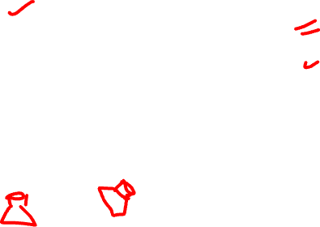
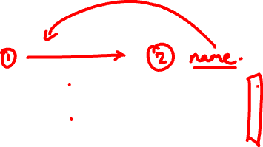
Harder case
by Diva Sian
by scgbt

Slide 9
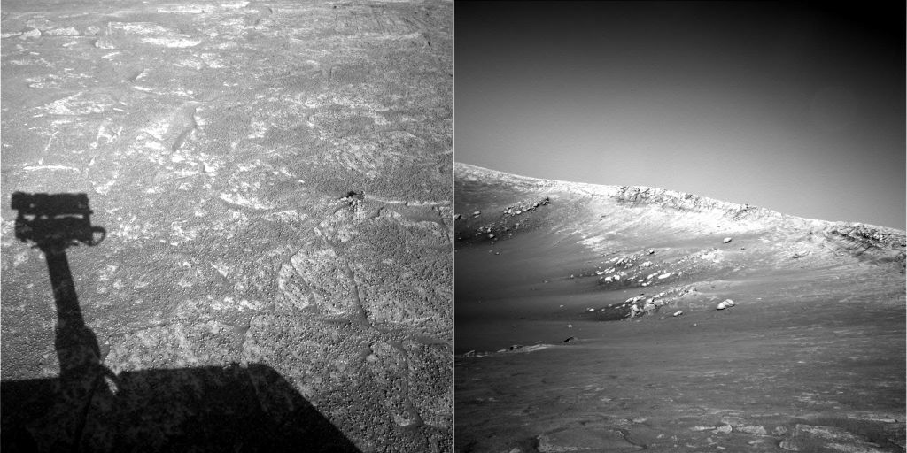

Harder still?

Slide 10
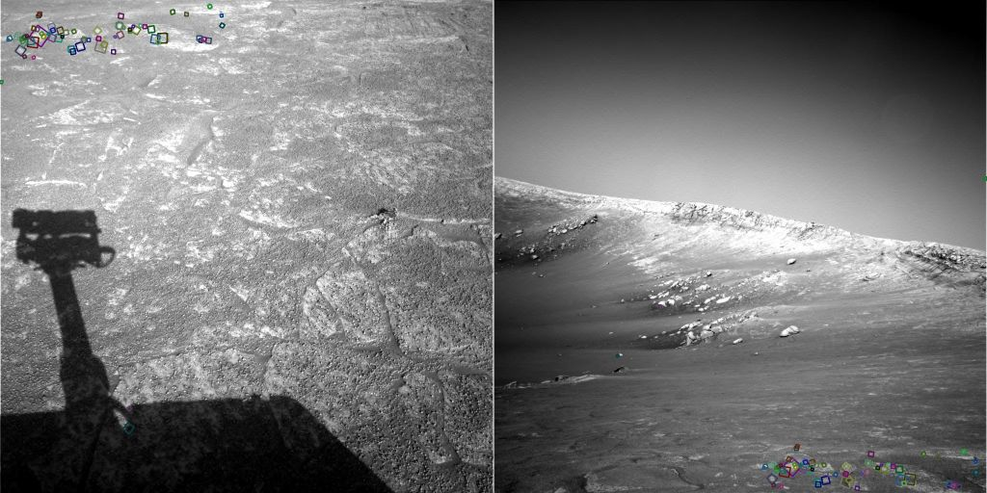


Answer below (look for tiny colored squares…)
NASA Mars Rover images with SIFT feature matches

Slide 11


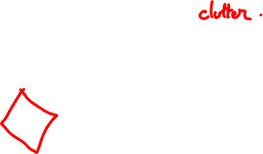

Feature matching for object search

Slide 12







Feature Matching

Slide 13
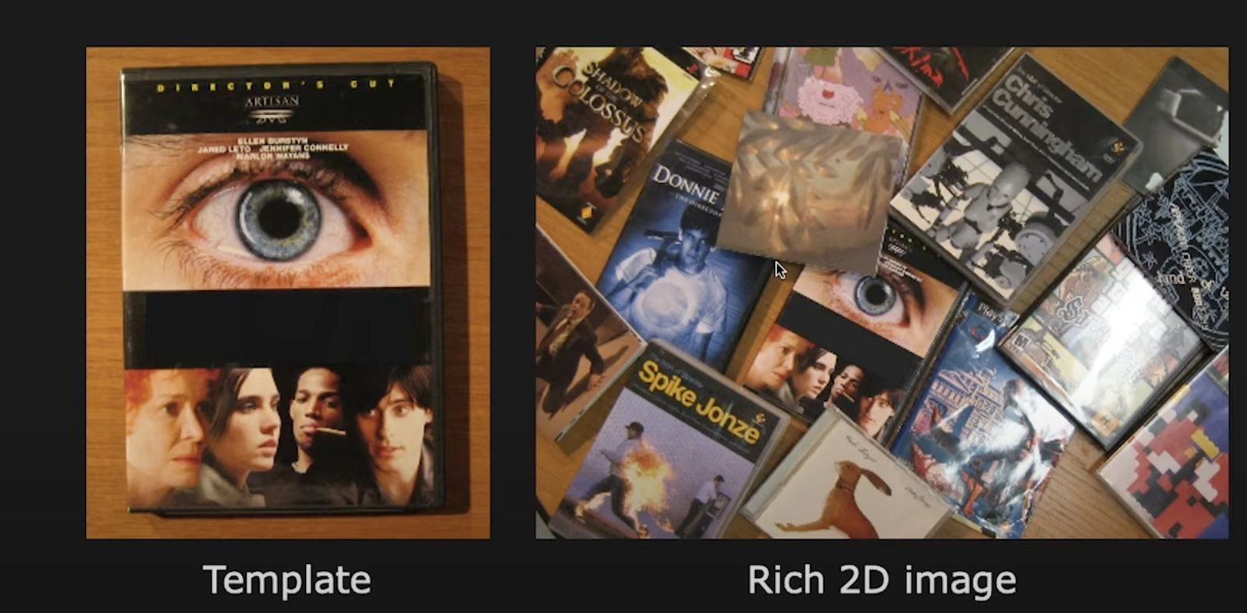


Object matching

Slide 14
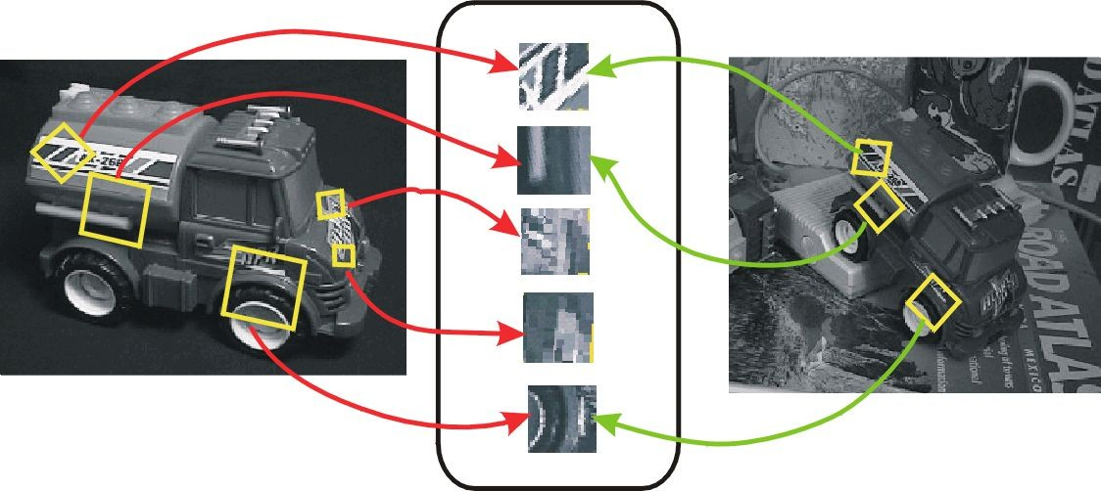
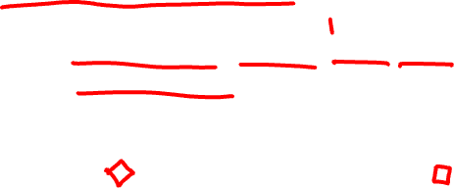
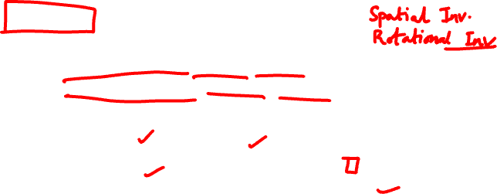
Invariant local features
Find features that are invariant to transformations
geometric invariance: translation, rotation, scale
photometric invariance: brightness, exposure, …
Feature Descriptors

Slide 15
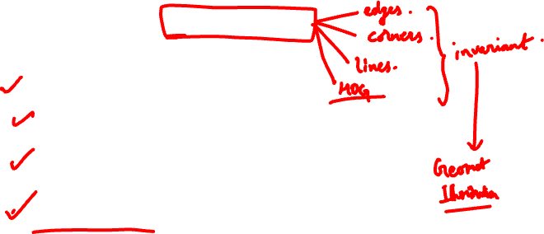

Advantages of local features
Locality
features are local, so robust to occlusion and clutter
Quantity
hundreds or thousands in a single image
Distinctiveness:
can differentiate a large database of objects
Efficiency
real-time performance achievable

Slide 16
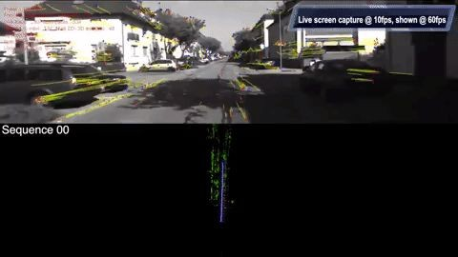


More motivation…
Feature points are used for:
Image alignment (e.g., mosaics)
3D reconstruction
Motion tracking (e.g. for AR)
Object recognition
Image retrieval
Robot/car navigation
… other

Slide 17
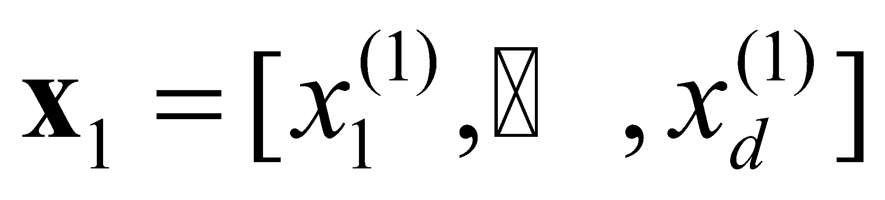
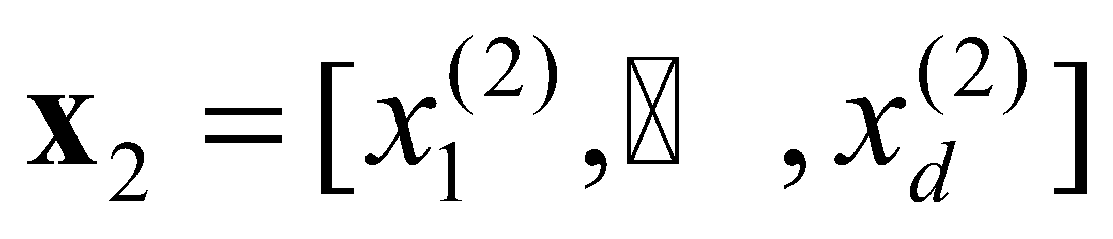
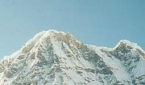


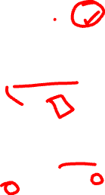
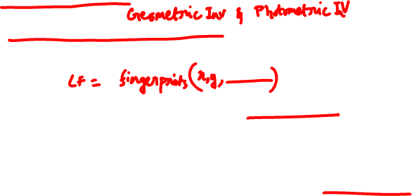
Local features: main components
Detection: Identify the interest points
Description: Extract vector
feature descriptor surrounding each interest point
Matching: Determine correspondence between descriptors in two views
Credit: Kristen Grauman

Slide 18
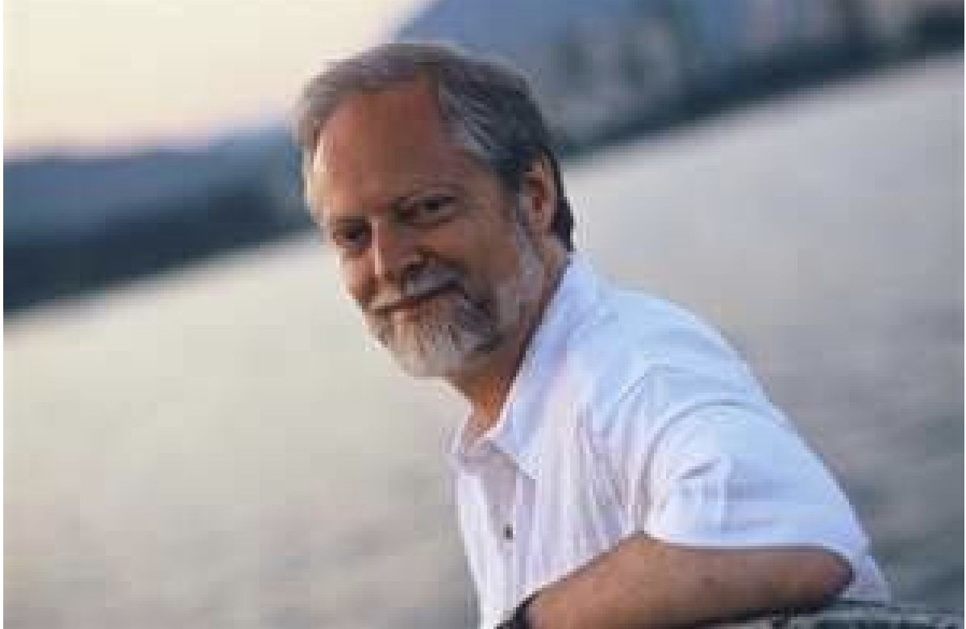
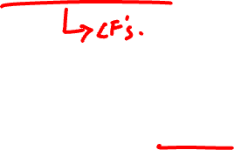
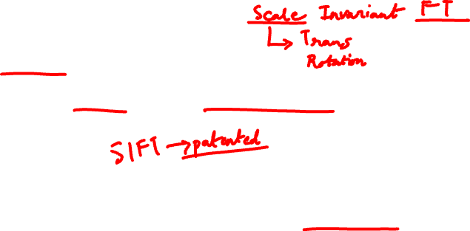
SIFT - Key point Extraction
Stands for scale invariant feature transform
Patented by university of British Columbia
Similar to the one used in primate visual system (human, ape, monkey, etc.)
Transforms image data into scale invariant coordinates
David Lowe, UBC
D. Lowe. Distinctive image features from scale-invariant key points., International Journal of Computer Vision 2004.

Slide 19
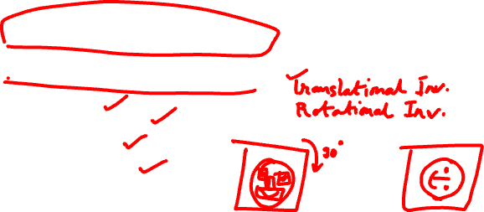
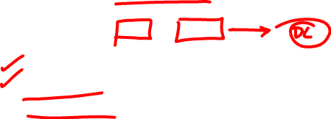
Goal
Extracting distinctive invariant features
Correctly matched against a large database of features from many images
Invariance to image scale and rotation
Robustness to
Affine distortion,
Change in 3D viewpoint,
Addition of noise,
Change in illumination.

Slide 20
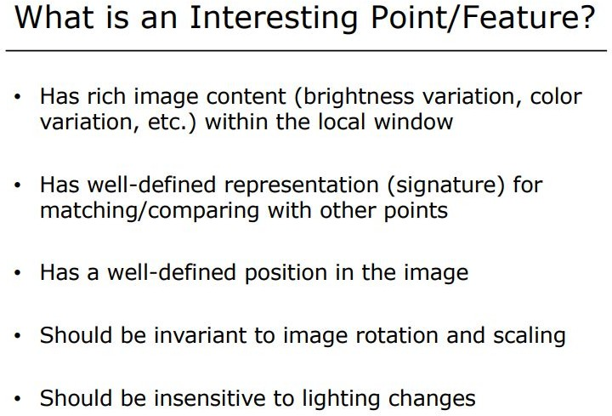



Slide 21
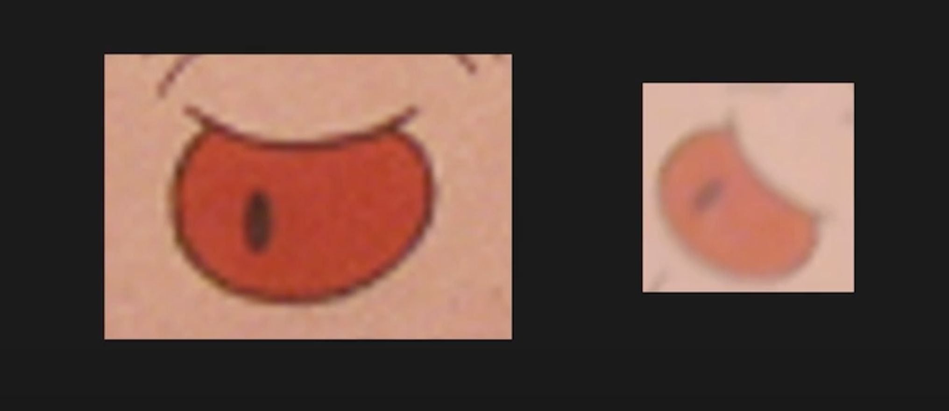
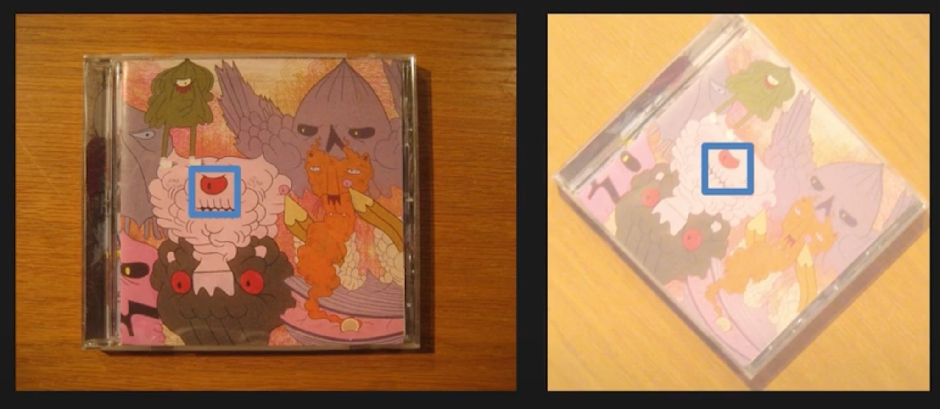
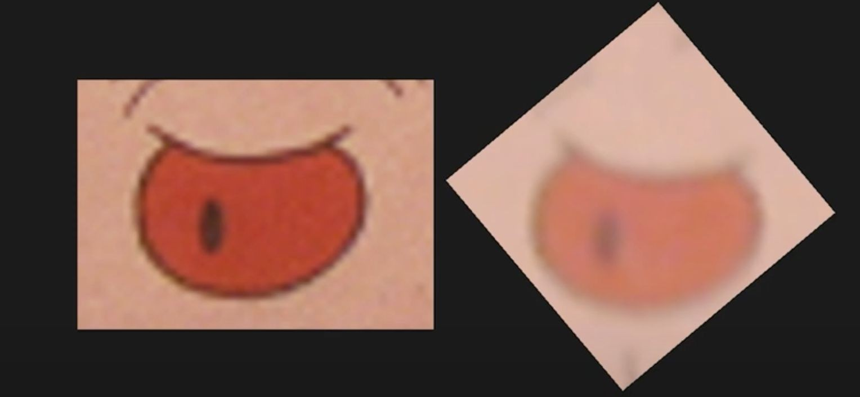
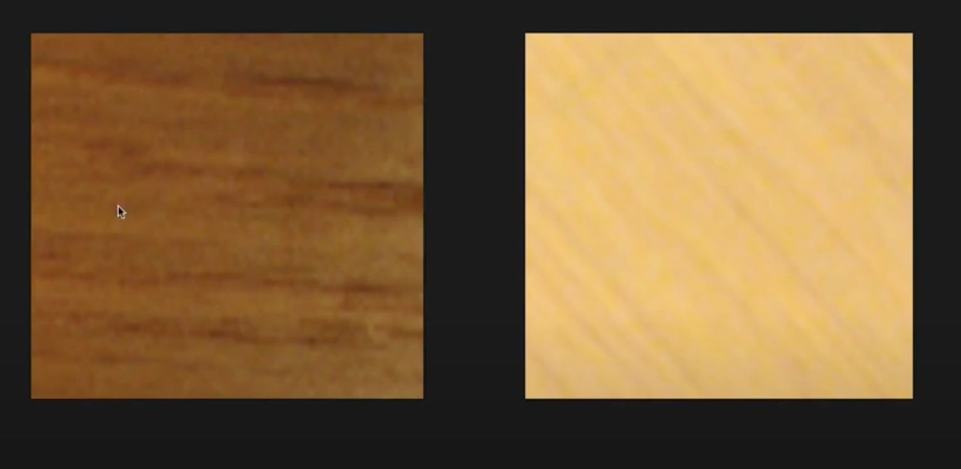


Raw image matching

Slide 22
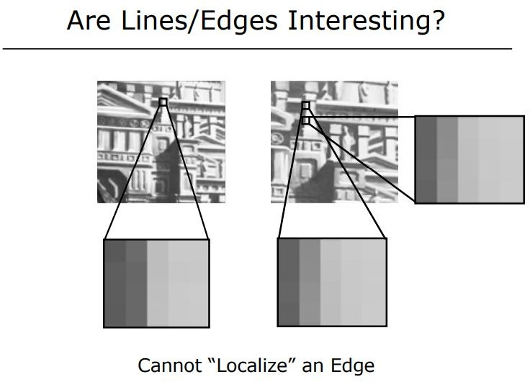
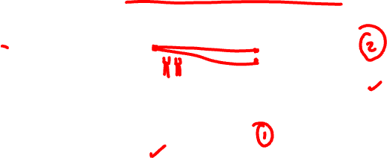
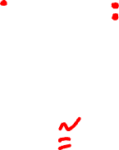
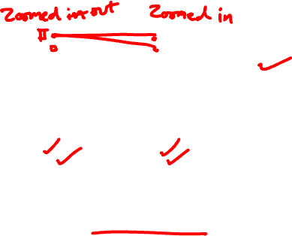

Slide 23
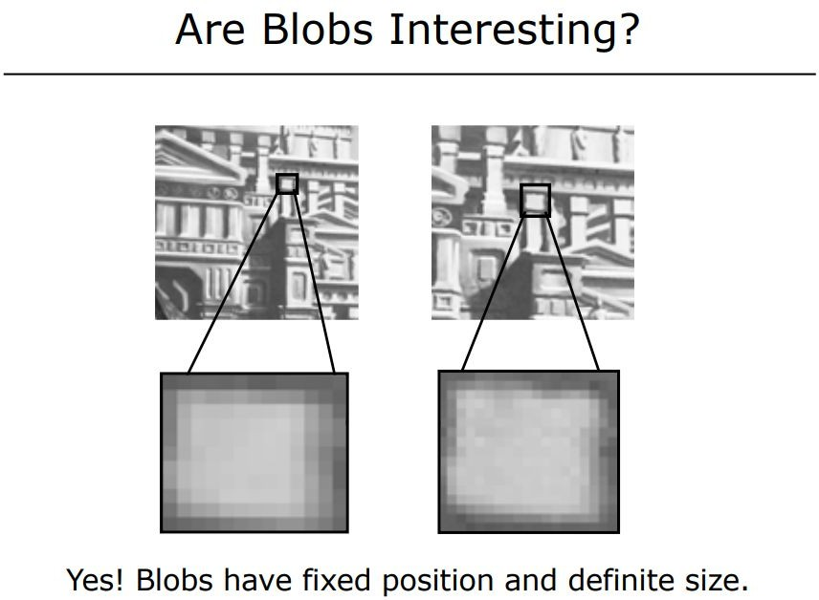
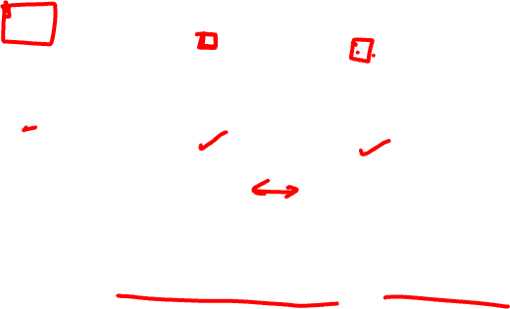

Slide 24
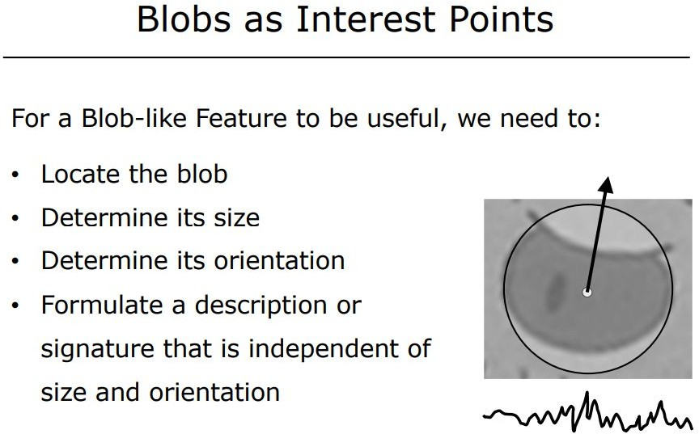






Slide 25





Slide 26





Slide 27




Slide 28




σ normalised

Slide 29




Slide 30



Variation in Scale σ

Slide 31



Variation in Scale σ

Slide 32



Slide 33

















1D Blob and 2^^{d} Derivative of Gaussian
- Blob A Blob B
Blob C
Characteristic Scale (•')
#/2
Local Extrema in (x, ‹r)-Space Represent Blobs
20

Slide 34






Slide 35





Slide 36




Slide 37





Slide 38



Slide 39





Slide 40





Slide 41




Slide 42






Slide 43





Slide 44





Slide 45






Slide 46

Gaussian Blurring

Slide 47




Space Scale construction
Credits: https://www.educative.io/answers/what-is-sift

Slide 48



Difference of Gaussian
https://www.cs.ubc.ca/~lowe/papers/ijcv04.pdf

Slide 49


Difference of Gaussians visualisation
https://www.analyticsvidhya.com/blog/2019/10/detailed-guide-powerful-sift-technique-image-matching-python/

Slide 50



Keypoint localization

Slide 51



Key point descriptor

Slide 52




Keypoint descriptor

Slide 53




SIFT descriptor

Slide 54


Slide 55


Slide 56

Scale Invariation

Slide 57


Slide 58




Slide 59



Rotation Invariation

Slide 60



Slide 61


Slide 62



Slide 63


Slide 64



Slide 65



Slide 66


Slide 67


Slide 68
Session #8:
Exam pattern, Revision, RANSAC
RANSAC slide credits: Cornell University

Slide 69
Exam pattern
4/5 questions, unequal weightage (7/8)
As per the course information shared
Expect across the contents covered so far
Mix of theory and numericals with More focus on Numerical understanding

Slide 70

Image Alignment Algorithm
Given images A and B
Compute image features for A and B
Match features between A and B
Compute homography between A and B using least squares on set of matches
What could go wrong?

Slide 71







Outliers
outliers
inliers

Slide 72




RANSAC
Line fitting example
Algorithm:
1. Sample (randomly) the number of points required to fit the model (#=2)
Solve for model parameters using samples
Score by the fraction of inliers within a preset threshold of the model
Repeat 1-­‐3 until the best model is found with high confidence
Illustration by Savarese

Slide 73

RANSAC
Line fitting example
Algorithm:
1. Sample (randomly) the number of points required to fit the model (#=2)
2. Solve for model parameters using samples
3. Score by the fraction of inliers within a preset threshold of the model
Repeat 1-­‐3 until the best model is found with high confidence

Slide 74


RANSAC
Line fitting example
δ
N_{I} = 6
Algorithm:
Sample (randomly) the number of points required to fit the model (#=2)
Solve for model parameters using samples
3. Score by the fraction of inliers within a preset threshold of the model
Repeat 1-­‐3 until the best model is found with high confidence

Slide 75



RANSAC
δ
N_{I} = 14
Algorithm:
Sample (randomly) the number of points required to fit the model (#=2)
Solve for model parameters using samples
Score by the fraction of inliers within a preset threshold of the model
Repeat 1-­‐3 until the best model is found with high confidence

Slide 76


RANSAC
Idea:
All the inliers will agree with each other on the translation vector; the (hopefully small) number of outliers will (hopefully) disagree with each other
RANSAC only has guarantees if there are < 50% outliers
“All good matches are alike; every bad match is bad in its own way.”
– Tolstoy via Alyosha Efros

Slide 77








Translations

Slide 78

RAndom SAmple Consensus
Output the translation with the highest number of inliers

Slide 79







Final step: least squares fit
Find average translation vector over all inliers

Slide 80


RANSAC
Inlier threshold related to the amount of noise we expect in inliers
Often model noise as Gaussian with some standard deviation (e.g., 3 pixels)
Number of rounds related to the percentage of outliers we expect, and the probability of success we’d like to guarantee
Suppose there are 20% outliers, and we want to find the correct answer with 99% probability
How many rounds do we need?

Slide 81

RANSAC pros and cons
Pros
Simple and general
Applicable to many different problems
Often works well in practice
Cons
Parameters to tune
Sometimes too many iterations are required
Can fail for extremely low inlier ratios
We can often do better than brute-­‐force sampling

Slide 82




Slide 83


Slide 84


Slide 85


Slide 86


Slide 87


Slide 88


